Slide 1

MILESTONE 2
Ashwin Chembu, Ruohan Huang, Trevor Lash, Mira Stenger,
Yuecheng Zhao

Slide 2

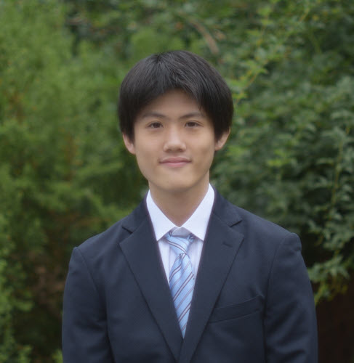




Another idea, equally important
TEAM
Yuecheng Zhao
Mira Stenger
Ruohan Huang
Trevor Lash
Ashwin Chembu
Changes in RID class, saving pages after buffer pool eviction, and extensive debugging
Buffer pool class, frame class, and general improvements upon M1
IO methods for the database, python compatibility
merge
merge/presentation

Slide 3
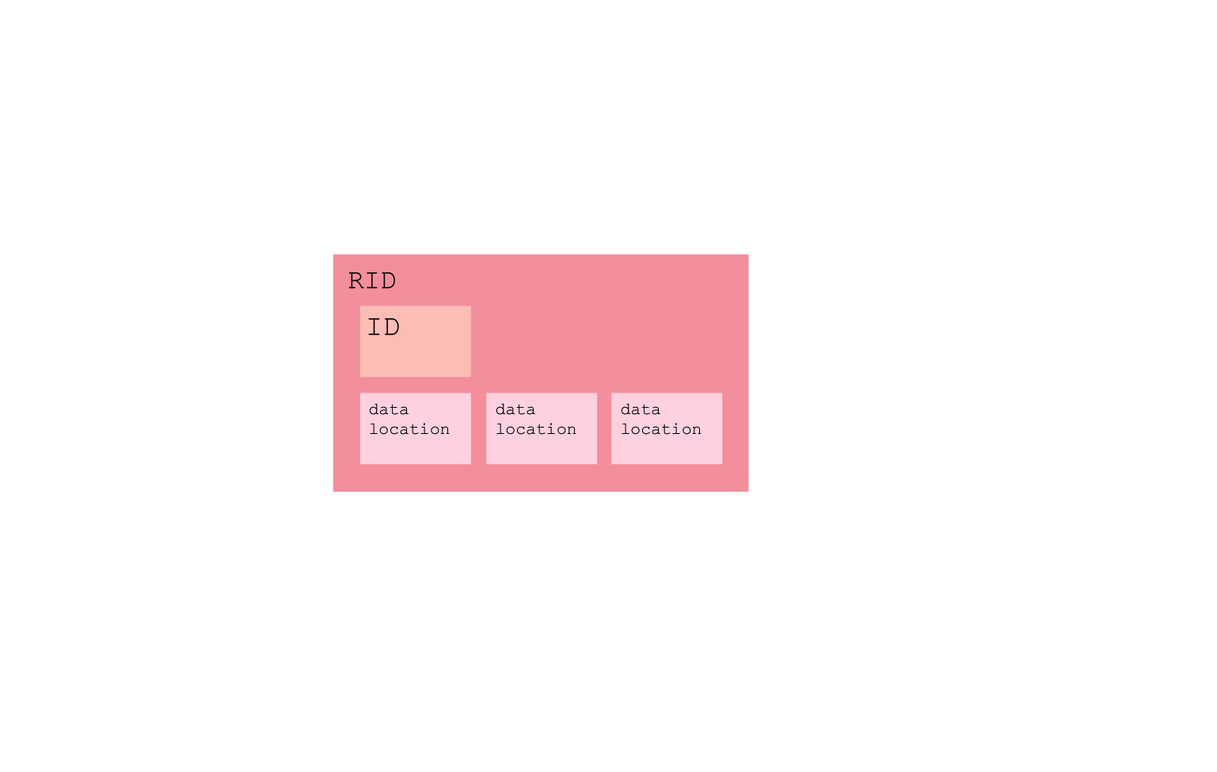
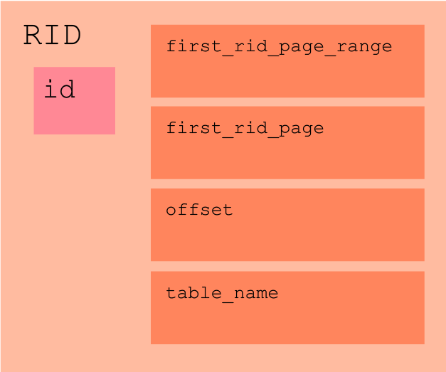
RID CLASS UPDATES
Previously Contained:
id
pointers to data locations
Currently Contains:
id
first rid of page range
first rid of logical page
offset on page
table name

Slide 4

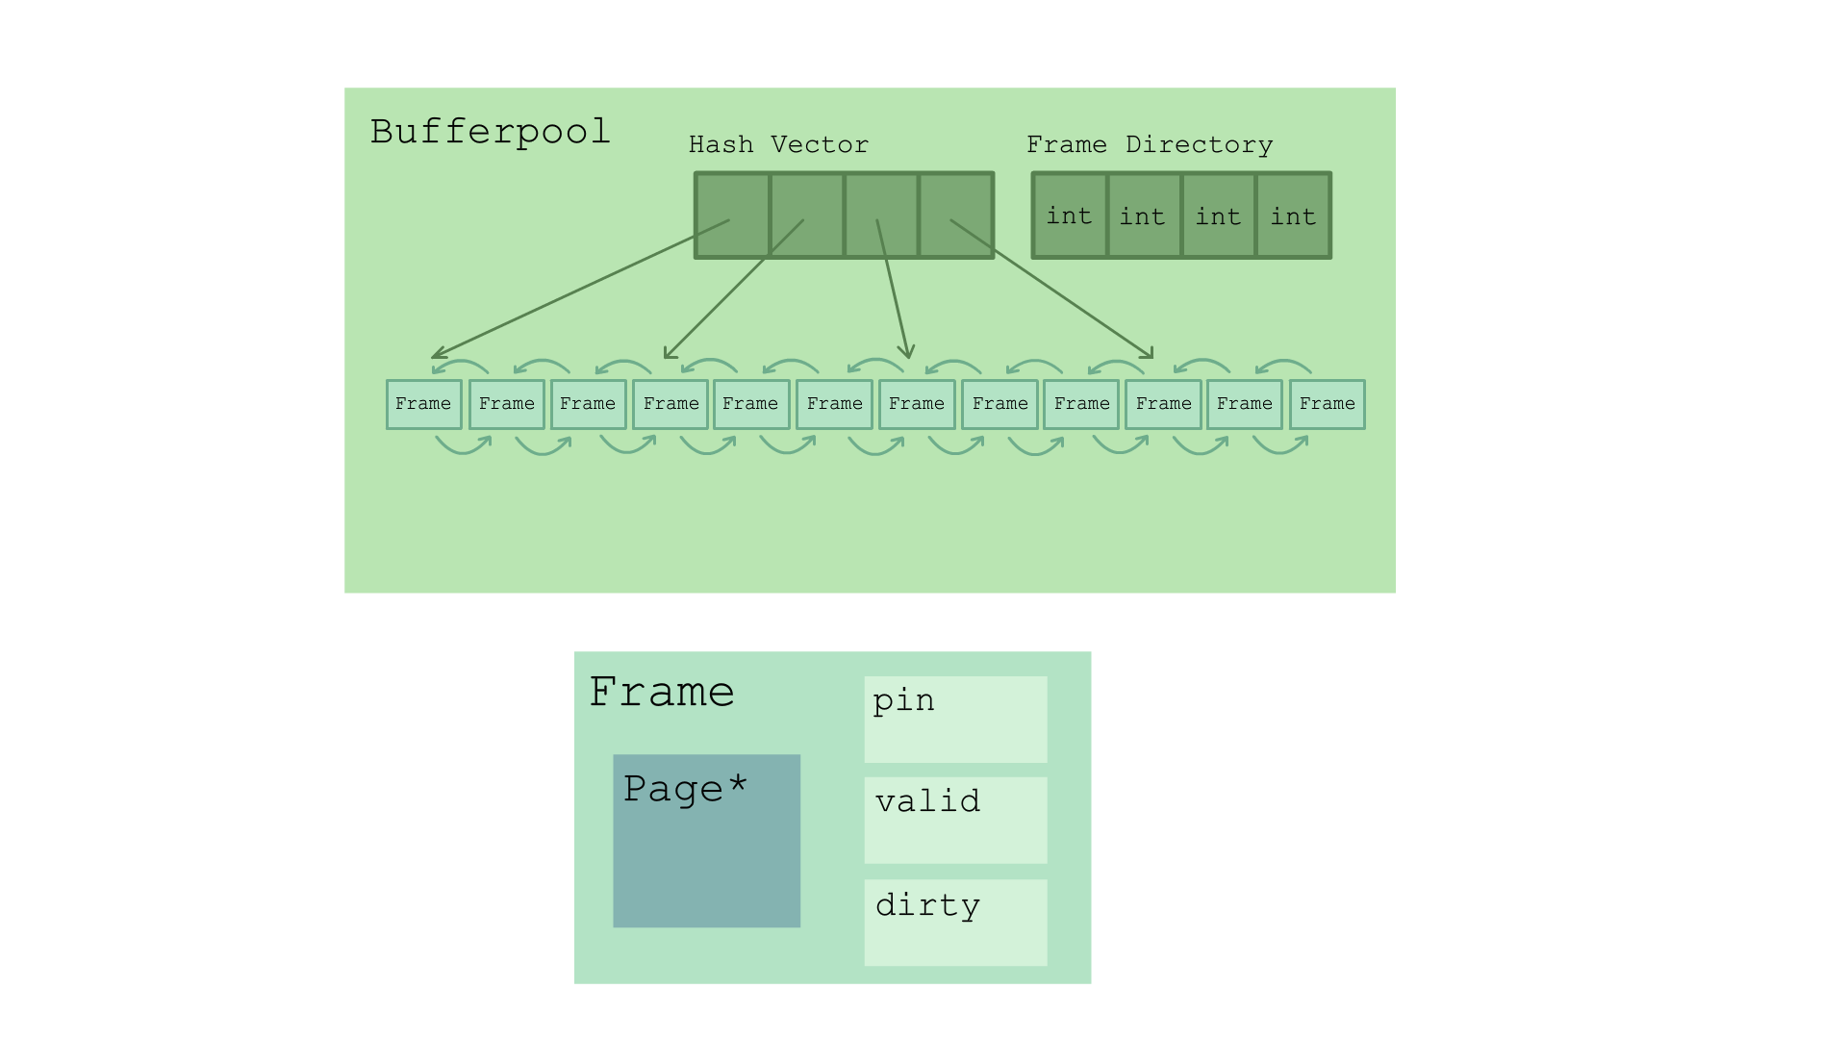
BUFFER POOL
Frame Class:
page
pin, valid, and dirty
Buffer Pool Structure:
doubly linked list
order represents relative age
increases likelihood of early termination when searching for recently accessed values or page to evict
Buffer Pool Hash:
Hash to partition buffer pool into smaller ranges to reduce search time
Hash vector keeps track of beginning frame for each range
frame directory keeps track of the number of occupied frames in each range

Slide 5
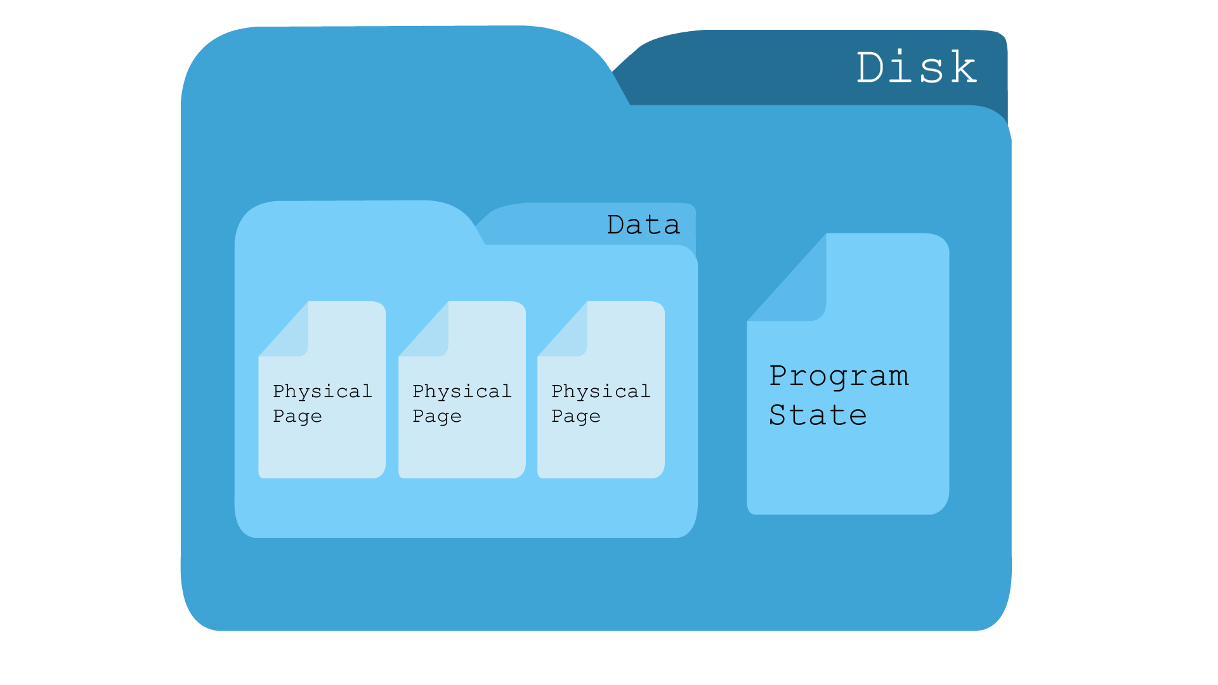

BUFFER POOL TO DISK
Storage Structure:
one physical page per file
each file stores number of rows and content of page
excellent durability
File Naming Convention:
table name_first RID of the page_first RID of the page range_column number
optimized saving and loading

Slide 6
MERGE
Purpose:
Consolidate multiple versions of records into a new base page.
Trigger:
Exceeding a predefined update threshold in a table or page range.

Slide 7
MERGE
PROCESS
Initiate
Load
Update
Consolidate
Redirect
Check if merge_queue has page ranges to merge
Bring base pages of the selected range into memory.
Iterate over tail pages to get the latest record for each base record.
Create a new base page with updated records.
Update the page directory to point to the new pages.

Slide 8

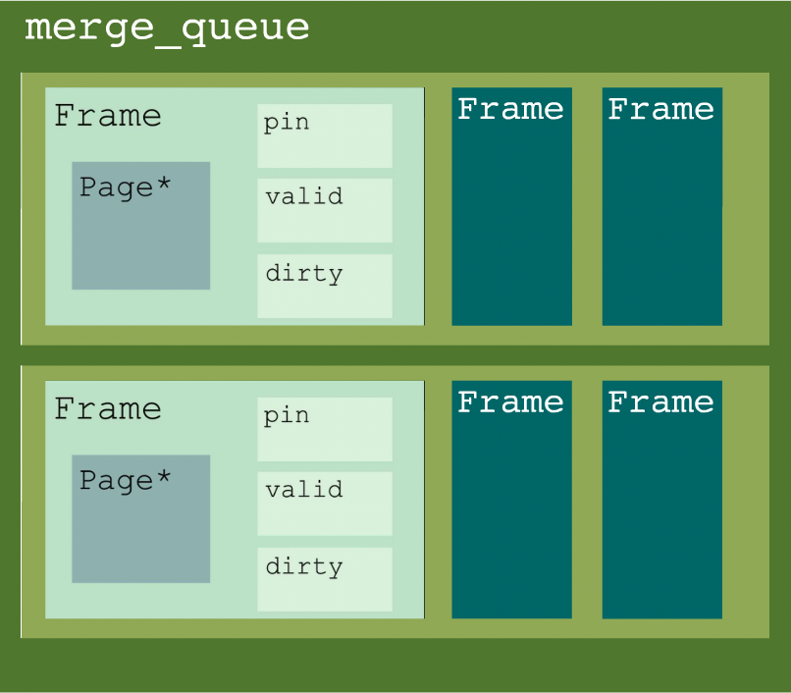
Another idea, equally important
MERGE
KEY COMPONENTS
merge_queue
mergeBufferPool

Slide 9
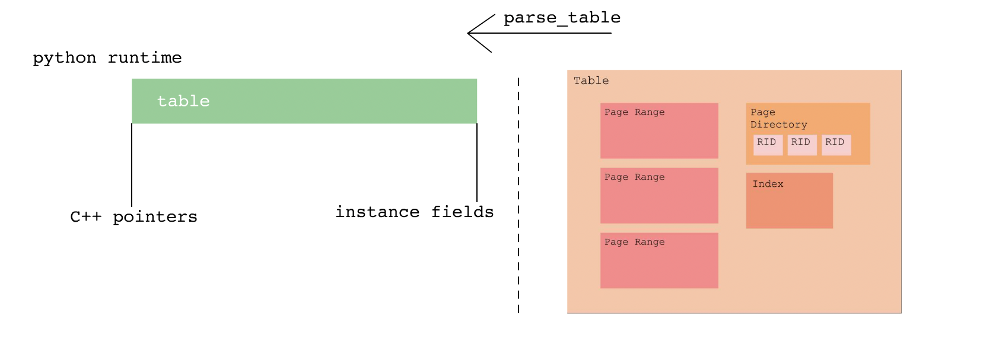
IO METHODS, WRAPPER MAINTENTANCE
Serialize the database to maintain its structure for future access.
Serialize table objects for query access and rid objects for logical page locations.
Serialize page objects to preserve disk states for later use.
Use parse_table to retrieve saved tables when the program restarts.

Slide 10

PERFORMANCE
Milestone 1
Inserting 10k: 0.12386
Updating 10k: 0.170233
Selecting 10k: 0.088323
Aggregate 10k: 0.021175
Deleting 10k: 0.005082
Milestone 2
Inserting 10k: 0.063621311 (195% faster)
Updating 10k: 0.118310865 (144% faster)
Selecting 10k: 0.134419101 (65% of M1)
Aggregate 10k: 0.003340502 (634% faster)
Deleting 10k: 0.008944553 (57% of M1)
Hardware used:
CPU : 2x Intel Xeon E5-2680 v2
Architecture : x86_64 Clock
Frequency : 2.80 GHz (Max 3.6 GHz)
Total L3 Cache Size : 50MiB
Bytes Order : Little Endian
Memory : 256GB (16GB x 16)
Clock Speed : 1866 MHz
Type : DIMM DDR3 Registered
Disk : Hardware RAID enabled

Slide 11

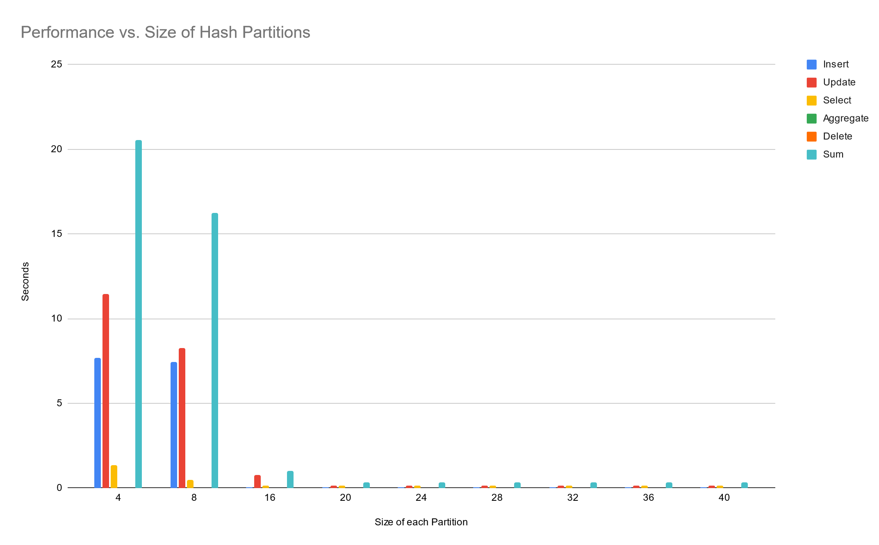
BUFFER POOL SIZE

Slide 12
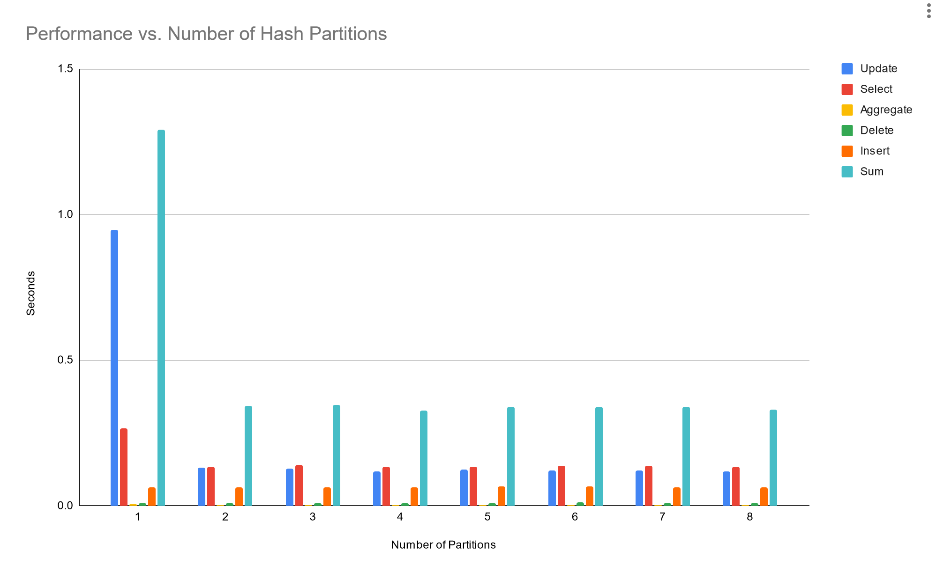
Another idea, equally important
NUMBER OF HASH PARTITIONS

Slide 13

THANK YOU

